Slide 1
MODULE-2
BCSE306
Artificial Intelligence
Dr.Priyanka N
Assistant Professor
School of Computer Science and Engineering (SCOPE),
VIT Vellore,
Priyanka.n@vit.ac.in

Slide 2
Breadth-first search
Breadth-first search (BFS) is an algorithm for traversing or searching tree or graph data structures.
It starts at the tree root (or some arbitrary node of a graph, sometimes referred to as a ‘search key’), and explores all of the neighbor nodes at the present depth prior to moving on to the nodes at the next depth level.
It is implemented using a queue(FIFO).
BFS traverses the tree “shallowest node first”, it would always pick the shallower branch until it reaches the solution (or it runs out of nodes, and goes to the next branch).

Slide 3
Algorithm
Declare a queue and insert the starting vertex.
Initialize a visited array and mark the starting vertex as visited.
Follow the below process till the queue becomes empty:
  Remove the first vertex of the queue.
  Mark that vertex as visited.
  Insert all the unvisited neighbors of the vertex into the queue.

Slide 4




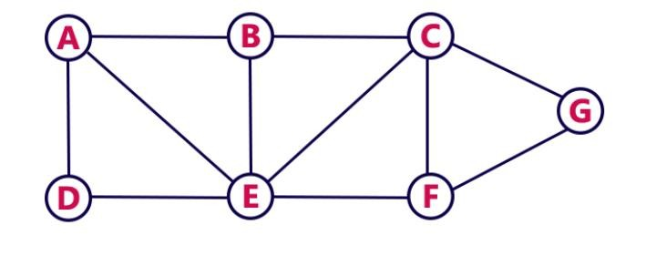
Example-1
Consider the Following Example

Slide 5
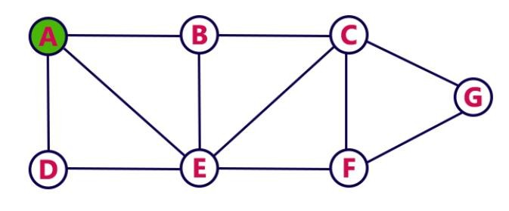
Breadth First Search- STEP1
Choose the Starting Vertex as A
VISIT A
Insert A into the Queue
QUEUE:
A

Slide 6
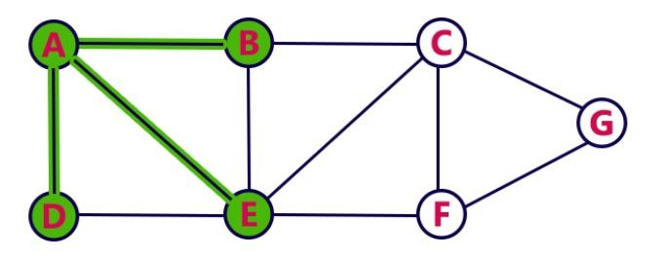
Breadth First Search- STEP2
Visit all adjacent vertices of A which are not visited(Here: D,E,B)
Insert newly visited vertices into the queue and delete A from the Queue
QUEUE:
 | D | E | B
RESULT: A

Slide 7
Breadth First Search- STEP3
Visit all adjacent vertices of D which are not visited (No Vertex)
Delete D from the Queue
QUEUE:
 |  | E | B
RESULT: A D

Slide 8
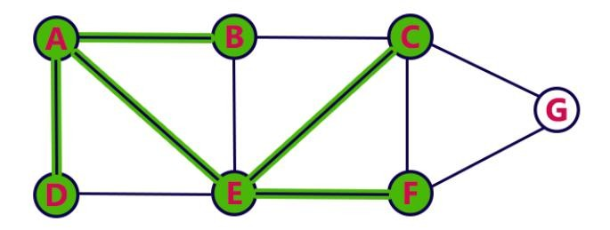
Breadth First Search- STEP4
Visit all adjacent vertices of E which are not visited(Here C, F)
Insert newly visited vertices into the queue and delete E from the Queue
QUEUE:
B
C
F
RESULT: A D E

Slide 9
Breadth First Search- STEP5
Visit all adjacent vertices of B which are not visited(No Vertex)
Delete B from the Queue
QUEUE:
C
F
RESULT: A D E B

Slide 10
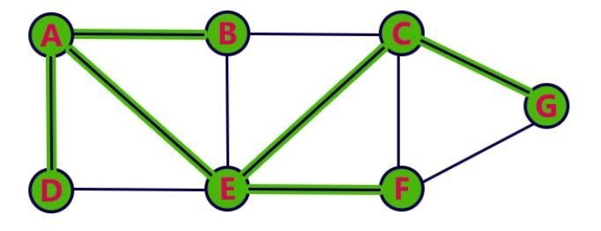
Breadth First Search- STEP6
Visit all adjacent vertices of C which are not visited(Here G)
Insert newly visited vertices into the queue and delete C from the Queue
QUEUE:
F
G
RESULT: A D E B C

Slide 11
Breadth First Search- STEP7
Visit all adjacent vertices of F which are not visited(Here No Vertex)
Delete F from the Queue
QUEUE:
G
RESULT: A D E B C F

Slide 12
Breadth First Search- STEP8
Visit all adjacent vertices of G which are not visited(Here No Vertex)
Delete G from the Queue
QUEUE:
RESULT: A D E B C F G
Queue Empty, End the Process

Slide 13
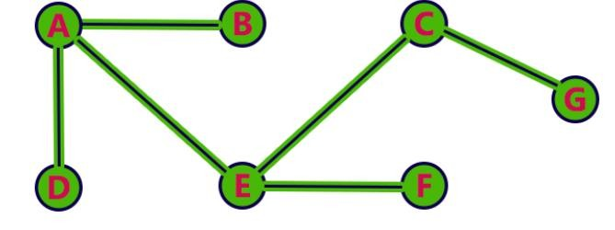
BFS Traversal - Result
A→D→E→B→C→F→G

Slide 14
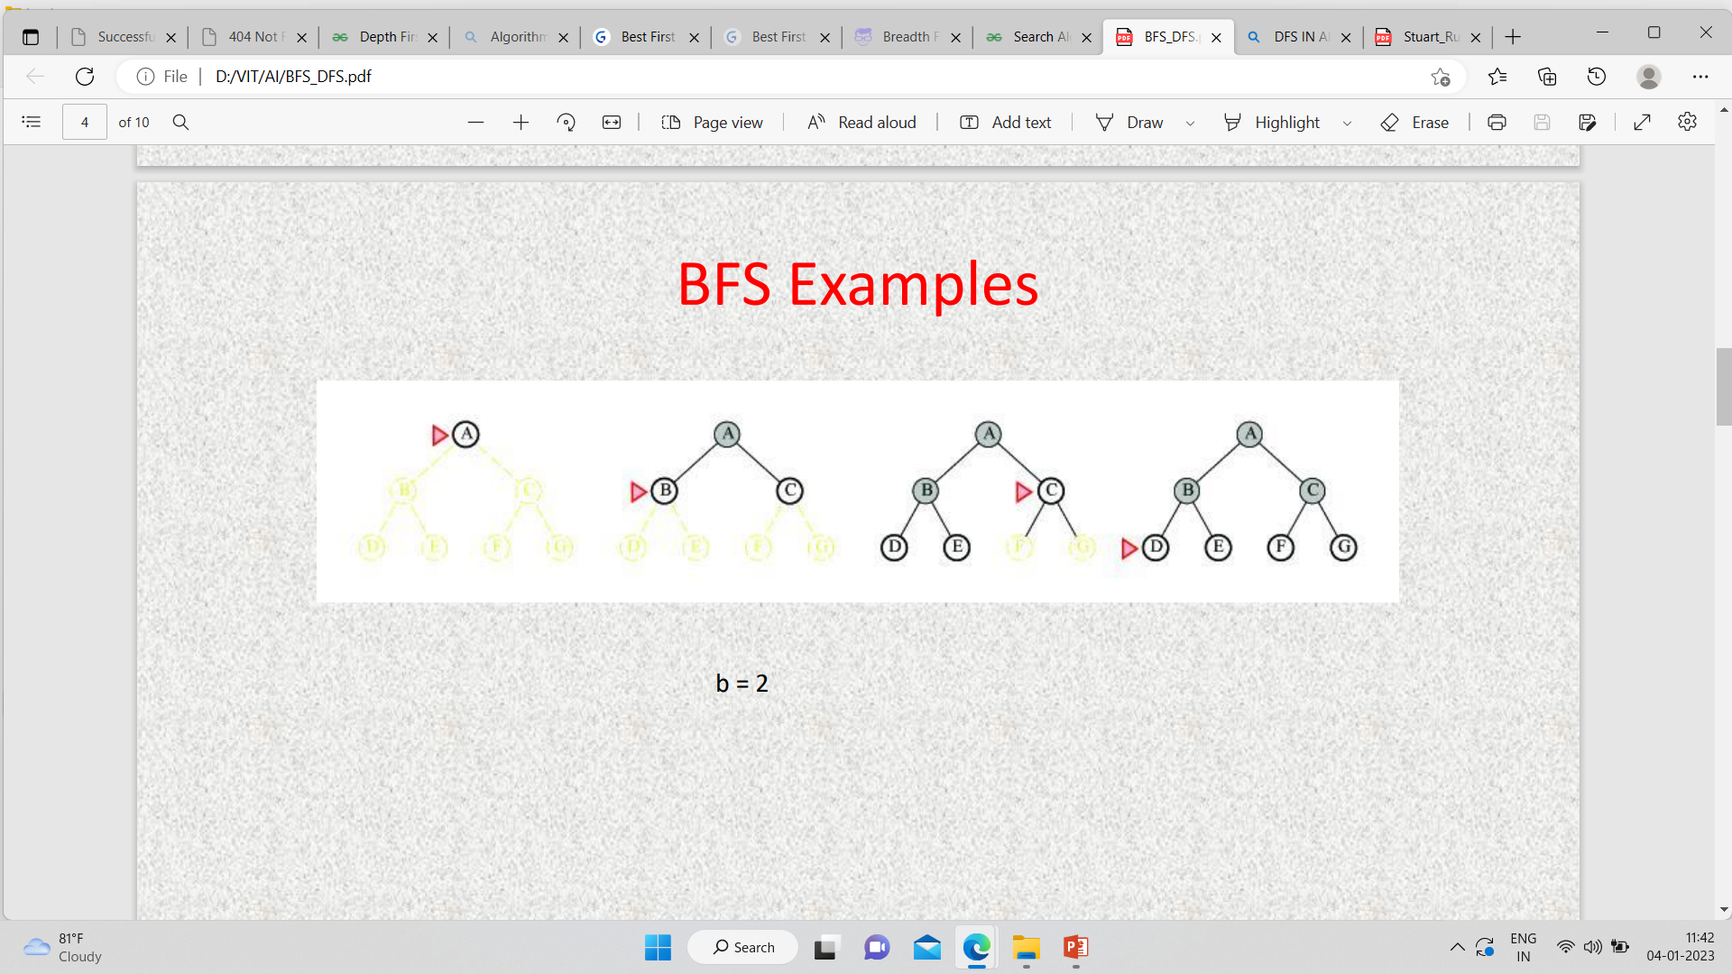
Example-2

Slide 15
Advantages
BFS will provide a solution if any solution exists.
If there are more than one solution for a given problem, then BFS will provide minimum solution which requires the least number of steps.
Disadvantage
It requires lot of memory since each level of the tree must be saved into memory to expand the next level.
BFS needs lot of time if the solution is far a way from the root.

Slide 16
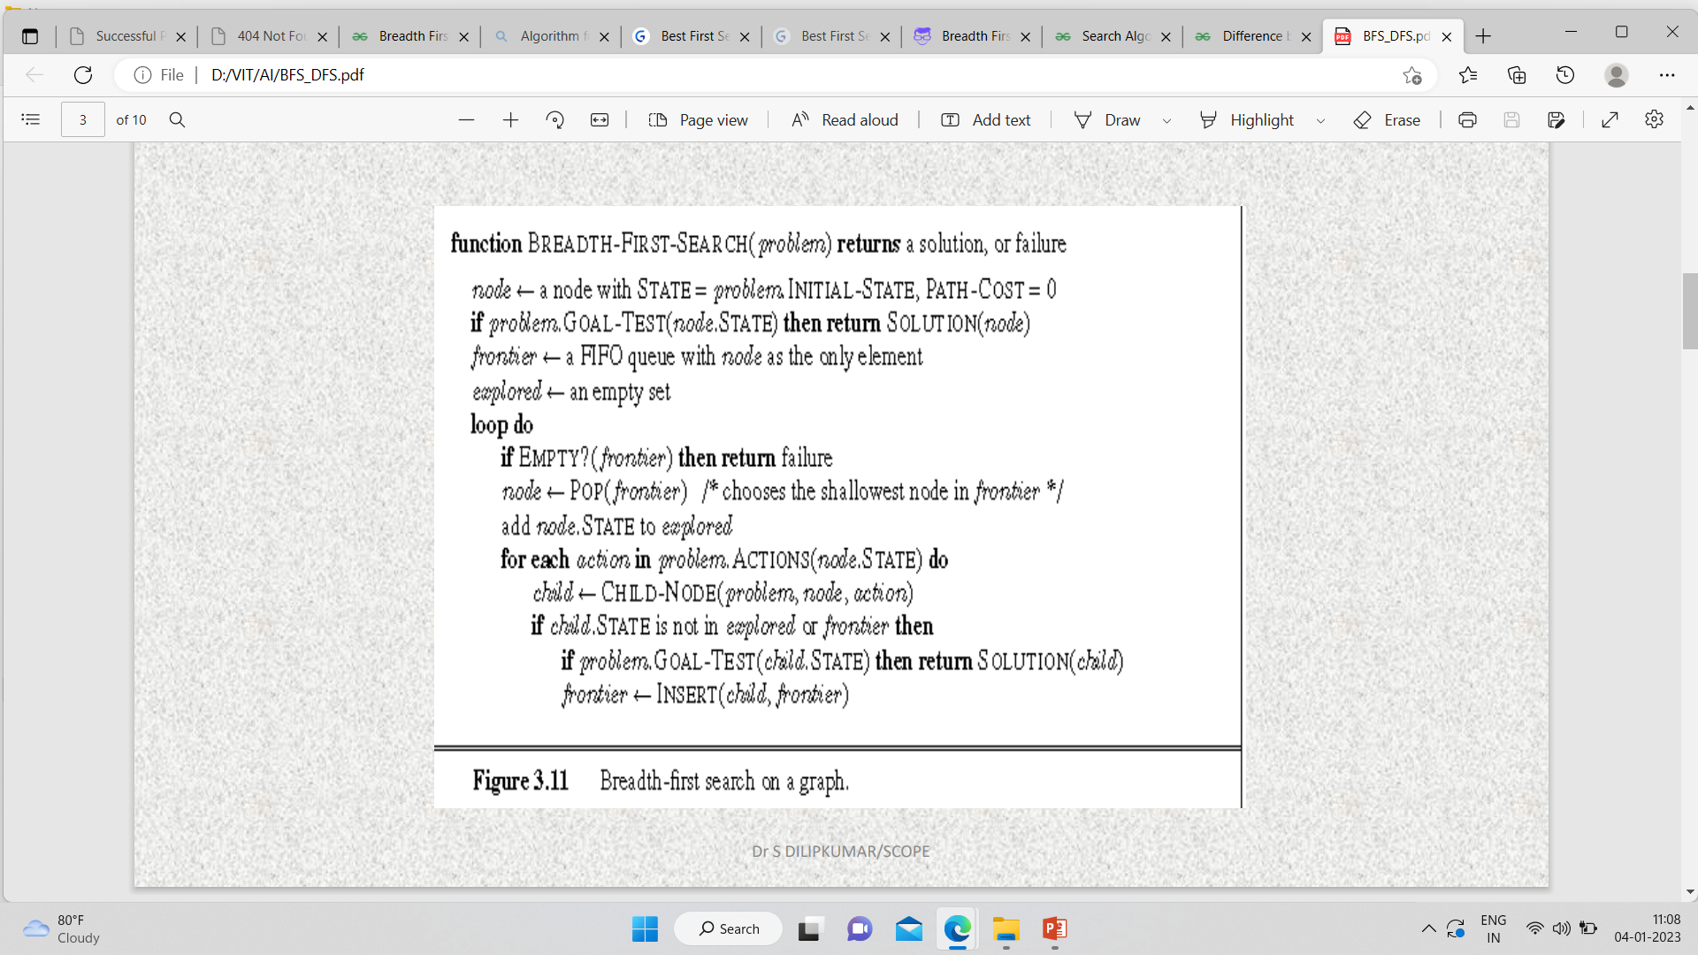
Algorithm of BFS

Slide 17
Time complexity: Equivalent to the number of nodes traversed in BFS until the shallowest solution.
  T(n) = 1 + n^2 + n^3 + ... + n^s = O(n^s)
s = the depth of the shallowest solution.
n^i = number of nodes in level i.
Space complexity: Equivalent to how large can the fringe get.
S(n) = O(n^s)

Slide 18
Completeness: BFS is complete, meaning for a given search tree, BFS will come up with a solution if it exists.
Optimality: BFS is optimal as long as the costs of all edges are equal.

Slide 19
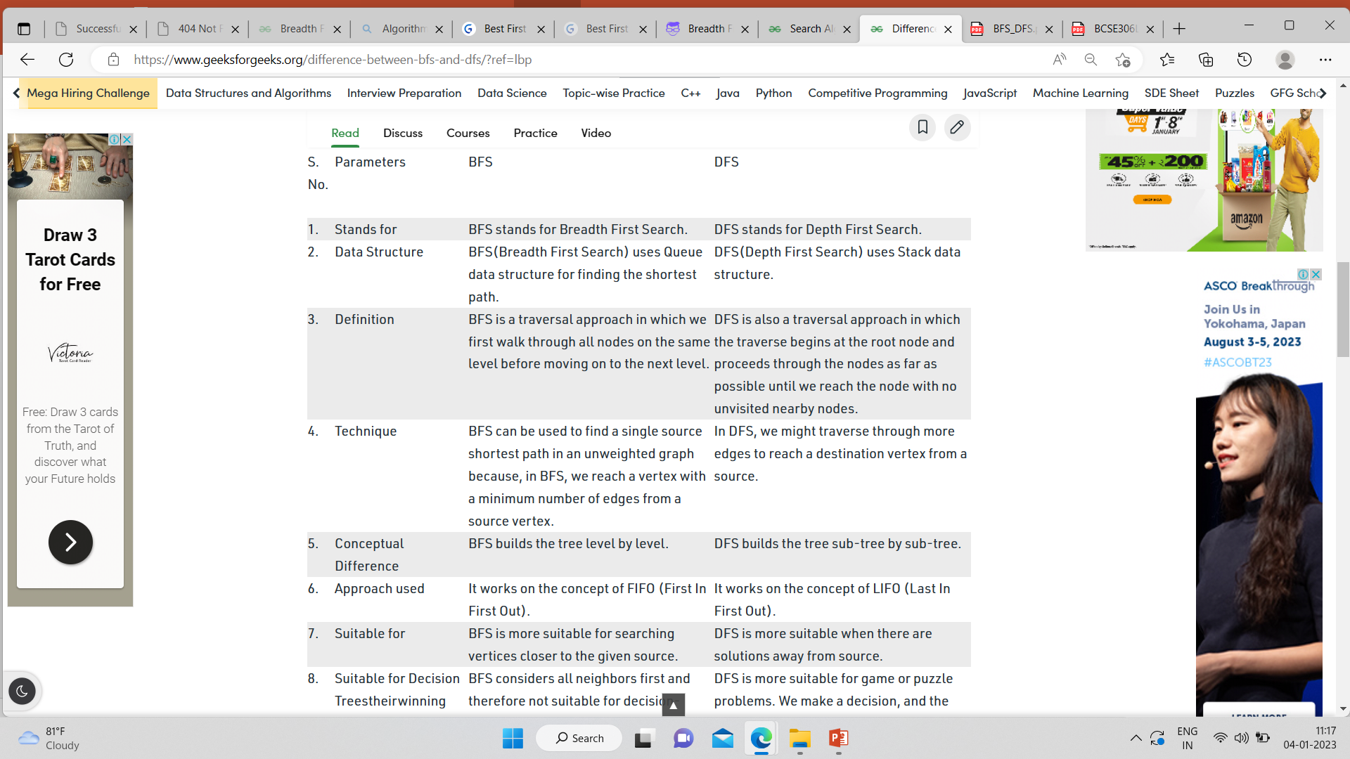


Slide 20
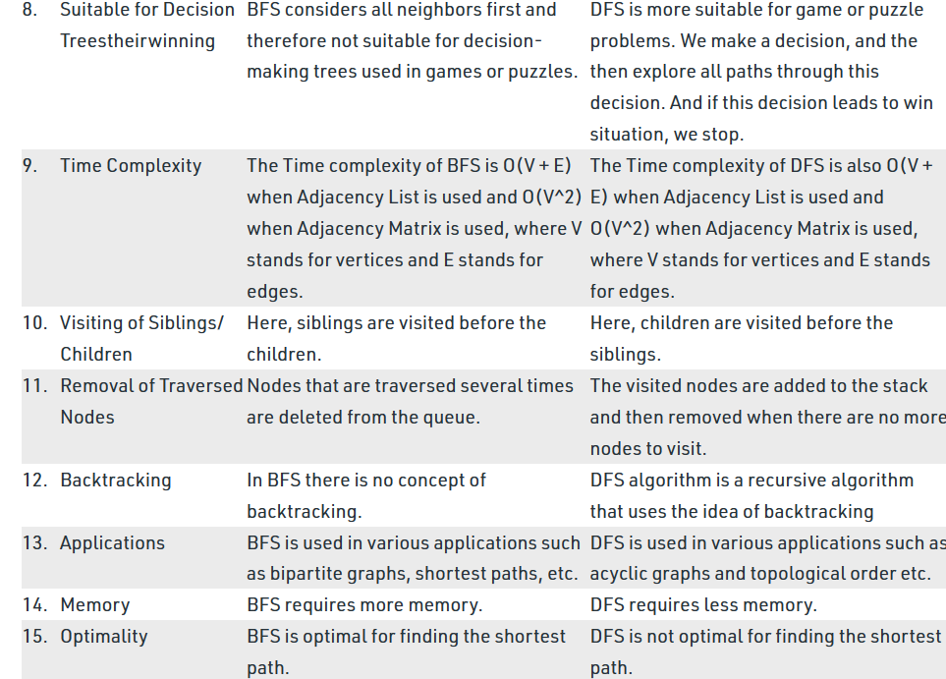

Slide 21
